Slide 1
Lecture 1

Slide 2
Goal of this Lecture
Understand what the terminal is.
Learn some useful commands in Terminal.
A basic understanding of Python.
A basic understanding of what Git is.
Use the back half of this lecture to go through the installation guide.

Slide 3
A Little Info About The Structure of Lectures
The notes are a transcript of what is being said in the lecture / so if you happen to skip a lecture due to any reasons, refer to the note.
If at any point in this lecture, you think you have a question, please feel free to ask. Also please feel free to stop me at any point in the lecture if you need more clarity on the topic.
The notes also have a ‘Go-Do-Your-Homework-Instead Section’ which is just a compilation of interesting facts related to that week’s lecture. Sometimes, I’ll add a fun exercise (for extra practice) that you can do after the lecture material. Feel free to skip it.

Slide 4
Terminal
There are many ways to interact with a computer i.e,. if you want to open a file on your computer, you normally go and click on the icon, etc. Terminal is a more concise way to interact with your computer.
Terminal is a program that allows you to interact with your computer by entering commands. If you’re on Mac/Linux, you have a program called Terminal and if you are using Windows, you should ideally have PowerShell. HOWEVER, by the end of this lecture, people on Windows should have Git Bash (aka a terminal for the Windows).
Terminal has a lot of useful commands that you can use to explore the folders (technically called directories) on your computer.
[DEMO]

Slide 5
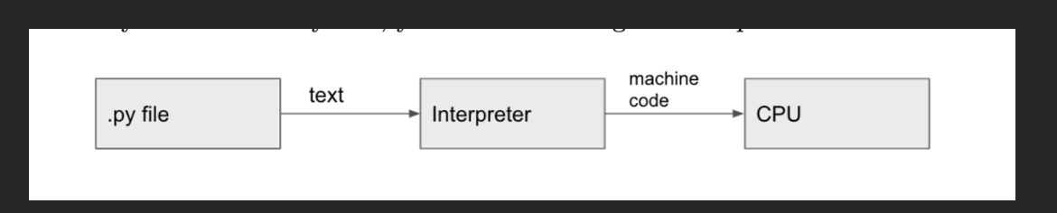
Python
Python is a high-level (something easily readable by humans) programming language with human-readable syntax. Why use it?
Popular in research (many libraries).
Fast code development
[DEMO]

Slide 6
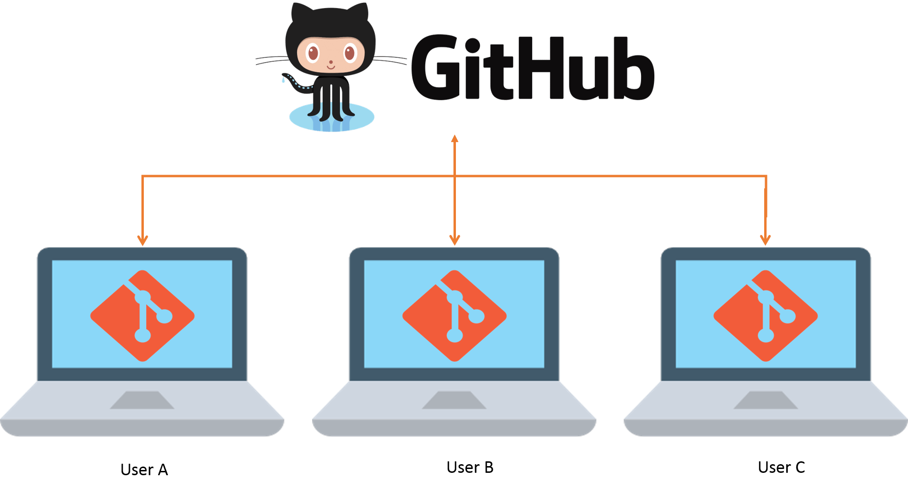
Git
Git and GitHub are extremely useful tools for writing and sharing code with your peers.
In more technical terms, Git is a distributed version control system. What does that mean? It means that if User A, User B and User C are collectively working on a project, they all have versions of that project on that computer. They can use Git to track and share their code.

Slide 7
Notes on Installation Guide
Use Git Bash instead of Powershell after you go through the installation guide.
For Mac/Linux, it is okay if echo $0 returns zsh. Zsh is built on top of bash and has additional features.

